Slide 1

CSE 460: VLSI Design
Week 11: VLSI Physical Design

Slide 2
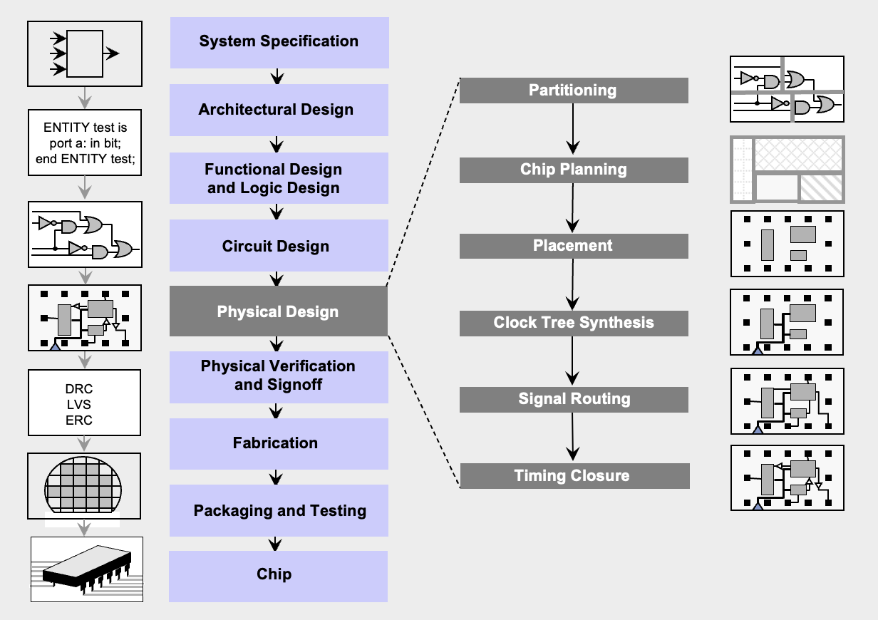
VLSI Design Flow

Slide 3
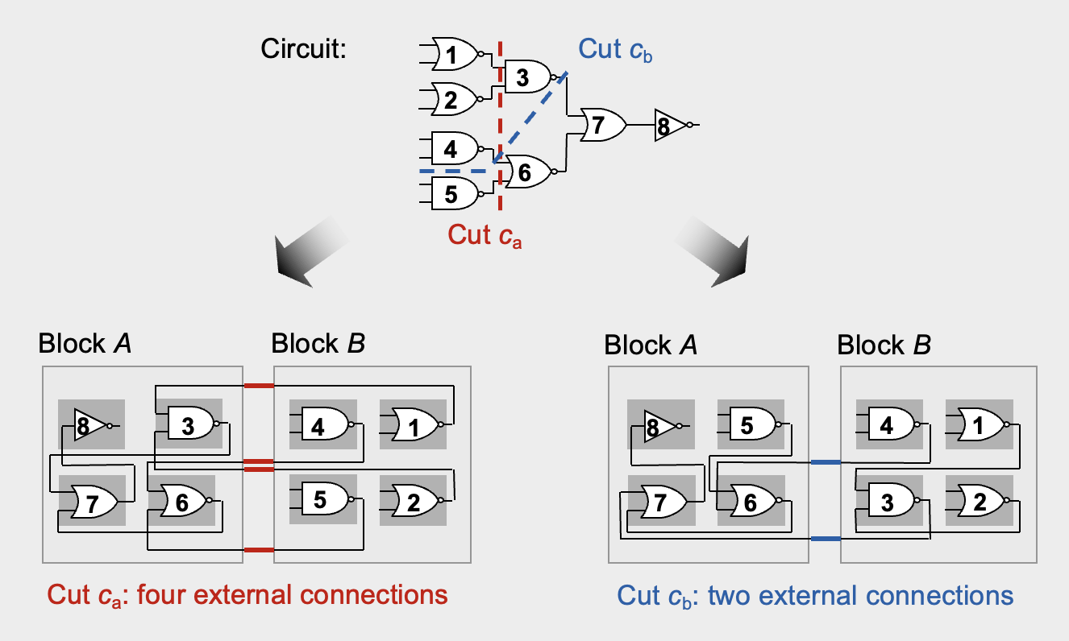
Partitioning
Algorithms Involved: Kernighan-Lin (KL) Algorithm, Fiduccia-Mattheyses (FM) Algorithm

Slide 4
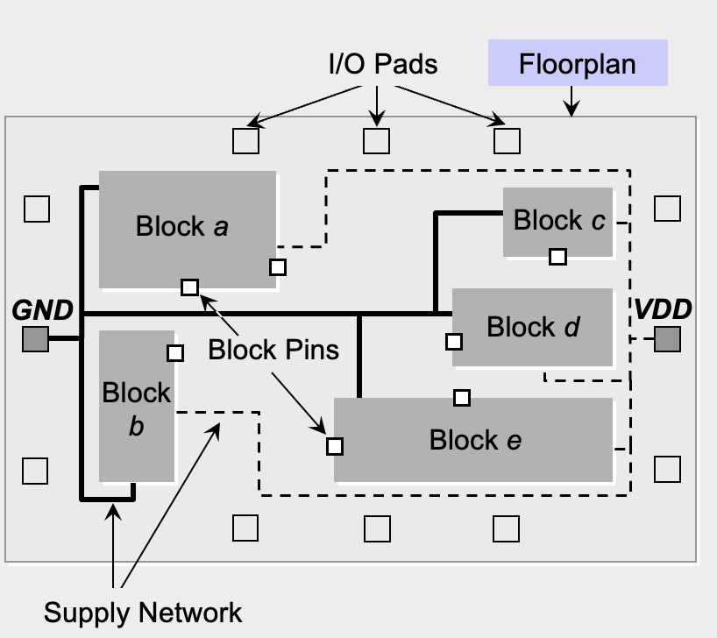
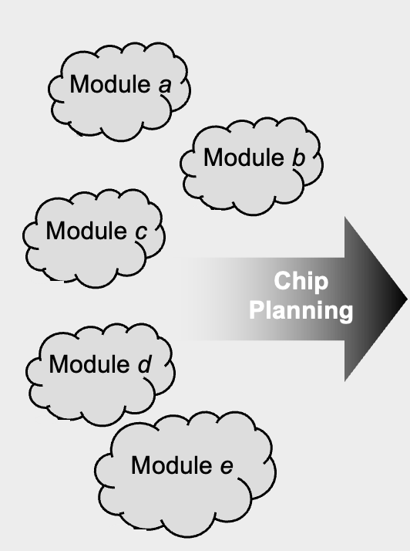
Chip Planning

Slide 5
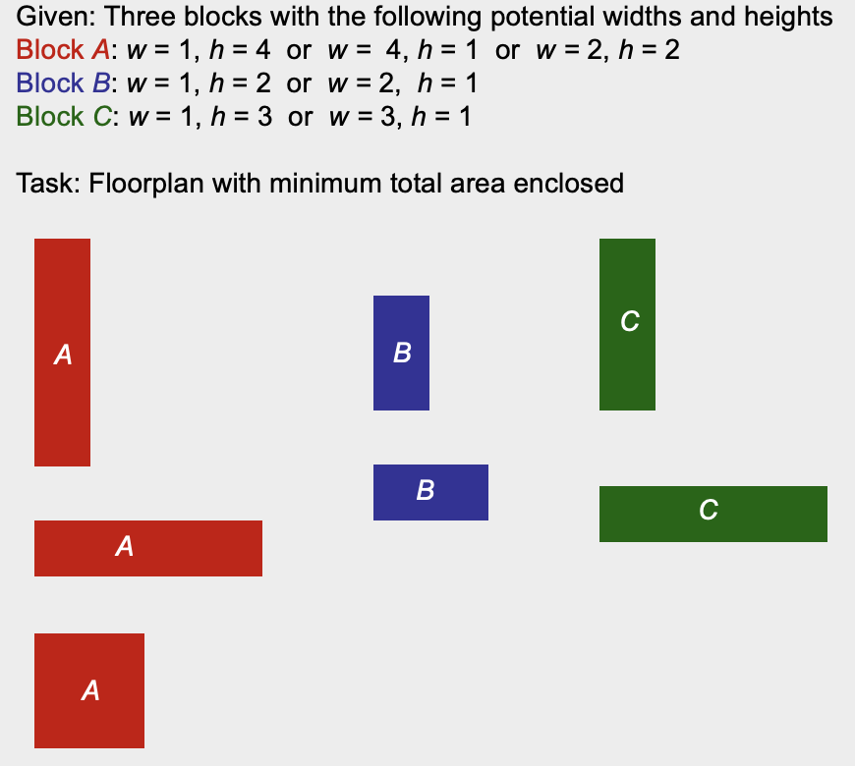
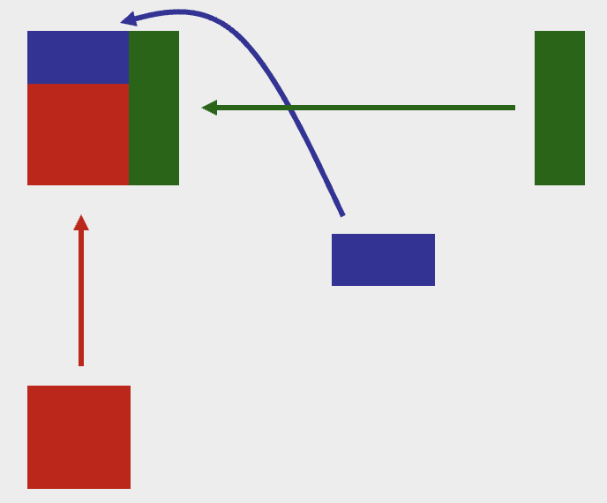
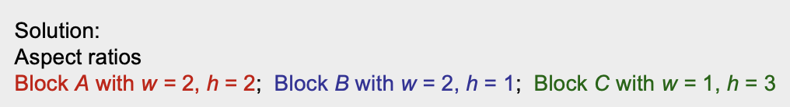
Chip Planning (Example)

Slide 6
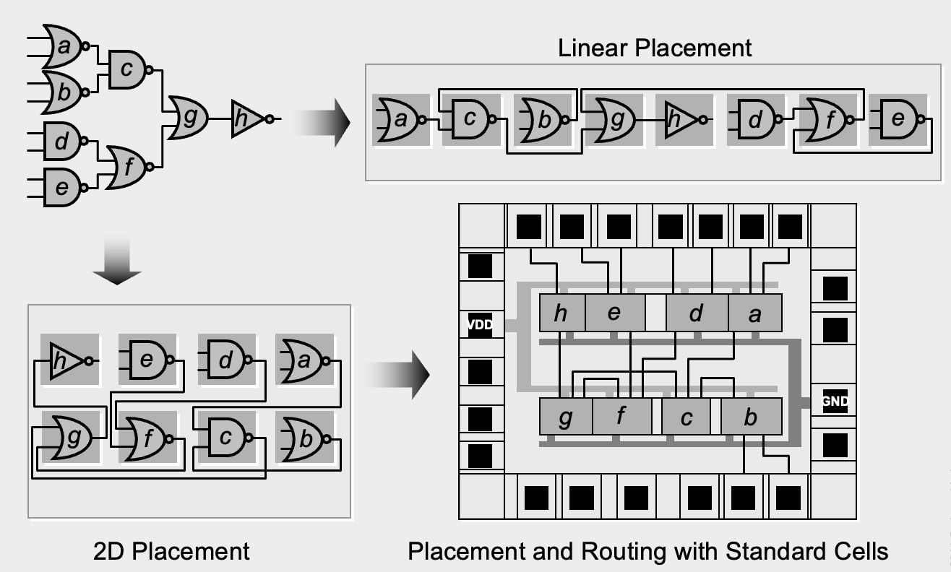
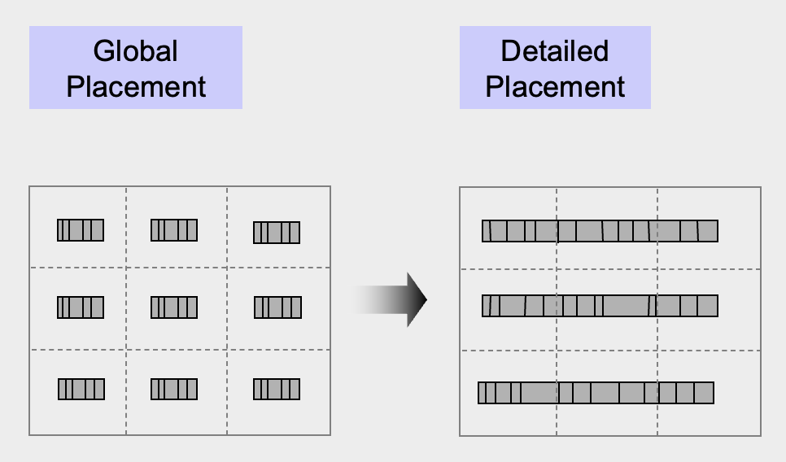
Placement

Slide 7
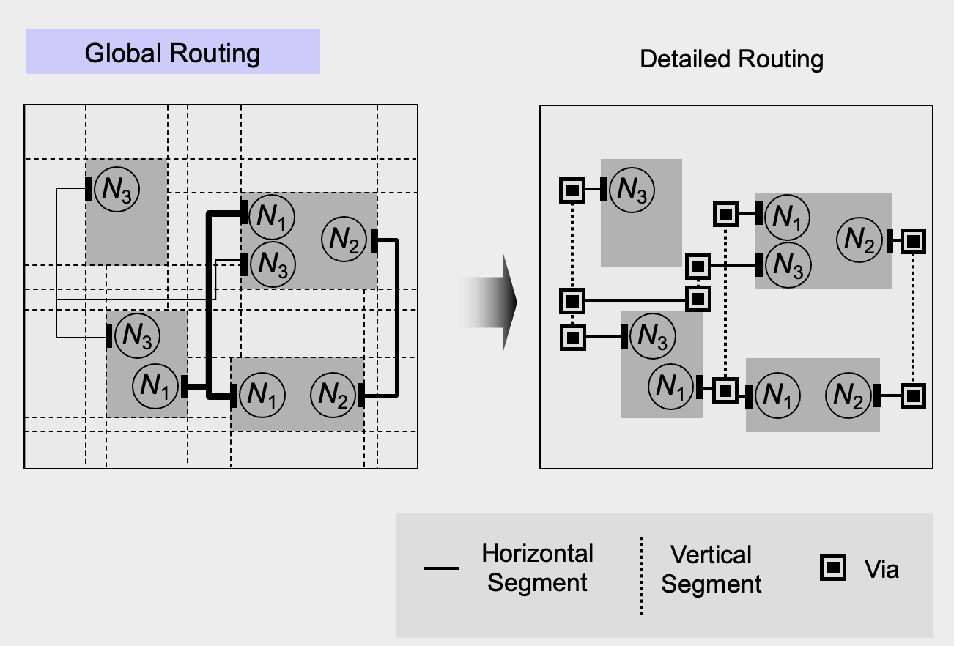
Signal Routing

Slide 8
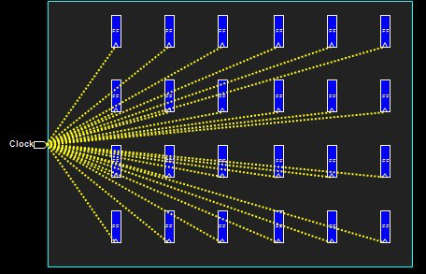
Clock Tree Synthesis (CTS)
Definition:
Clock tree synthesis is a process which make sure that the clock gets distributed evenly to all sequential elements in a design.
CTS is the process of insertion of buffers or inverters along the clock paths of ASIC design in order to achieve minimum skew or balanced skew.
In ICs, clock consumes around half of the total power consumption. Here clock gating technique helps to reduce power consumption by the clocks.
Goals of CTS:
To meet clock tree design rule constraints such as maximum transition, maximum load capacitance and maximum fanout.
To meet clock tree targets such as minimum skew and minimum insertion delay.

Slide 9
Timing Closure
Timing closure is the process by which a logic design consisting of primitive elements such as combinatorial logic gates ( and , or , not , nand , nor , etc.) and sequential logic gates (flip flops, latches, memories) is modified to meet its timing requirements.
Timing closure is done through layout optimizations and netlist modifications.

Slide 10
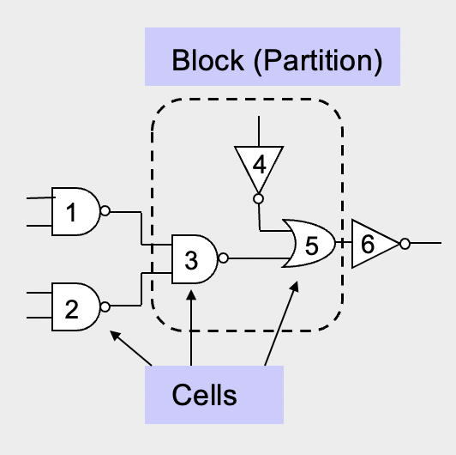
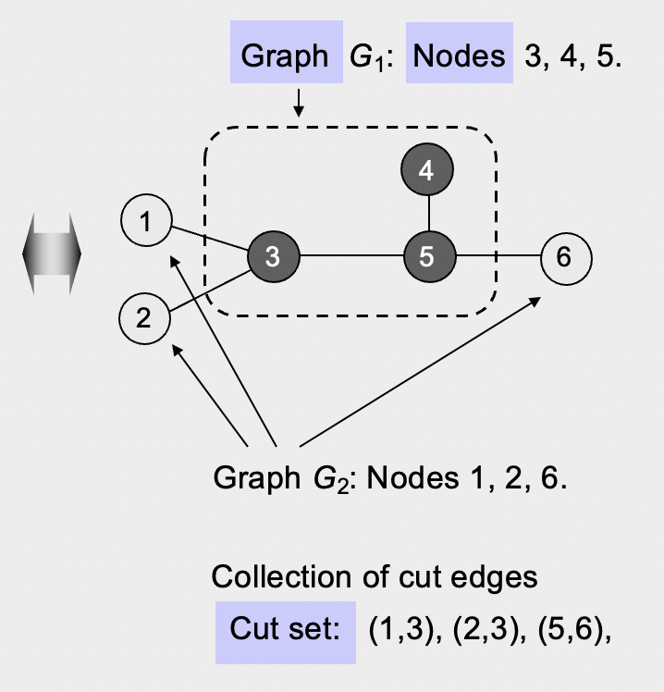
Partition Terminology

Slide 11
Optimization Goals
Given a graph G(V,E) with |V| nodes and |E| edges where each node v ⍷ V and each edge e ⍷ E.
Each node has area s(v) and each edge has cost or weight w(e).
The objective is to divide the graph G into k disjoint subgraphs such that all optimization goals are achieved and all original edge relations are respected.

Slide 12
Optimization Goals
In detail, what are the optimization goals?
Number of connections between partitions is minimized
Each partition meets all design constraints (size, number of external connections..)
Balance every partition as well as possible
How can we meet these goals?
Unfortunately, this problem is NP-hard
Efficient heuristics are developed in the 1970s and 1980s. They are high quality and in low-order polynomial time.

Slide 13
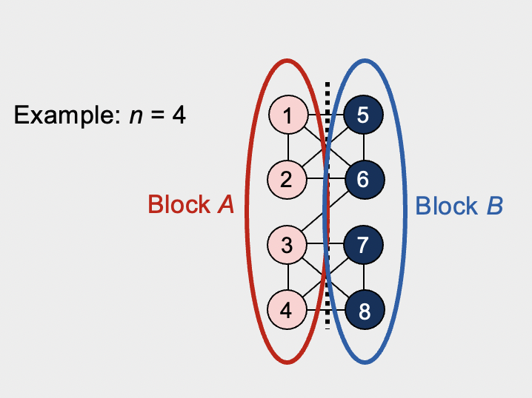
Kernighan Lin (KL Algorithm)
Given: A graph with 2n nodes where each node has the same weight.
Goal: A partition (division) of the graph into two disjoint subsets A and B with minimum cut cost and |A| = |B| = n.

Slide 14
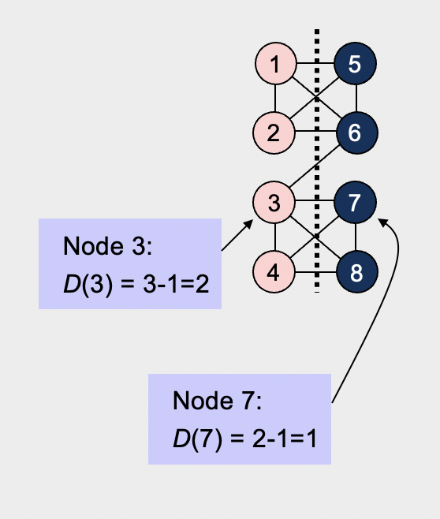
KL Algorithm (Terminology)
Cost D(v) of moving a node v
D(v) = |E_{c}(v)| – |E_{nc}(v)| ,
where
E_{c}(v) is the set of v’s incident edges that are cut by the cut line, and
E_{nc}(v) is the set of v’s incident edges that are not cut by the cut line.
High costs (D > 0) indicate that the node should move, while low costs (D < 0) indicate that the node should stay within the same partition.

Slide 15
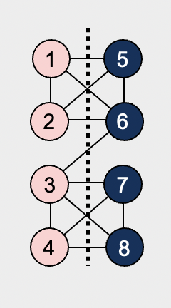
KL Algorithm (Terminology)
Gain of swapping a pair of nodes a und b
Δg = D(a) + D(b) - 2* c(a,b),
where
D(a), D(b) are the respective costs of nodes a, b
c(a,b) is the connection weight between a and b:
If an edge exists between a and b, then c(a,b) = edge weight (here 1),
otherwise, c(a,b) = 0.
The gain Δg indicates how useful the swap between two nodes will be
The larger Δg, the more the total cut cost will be reduced

Slide 16
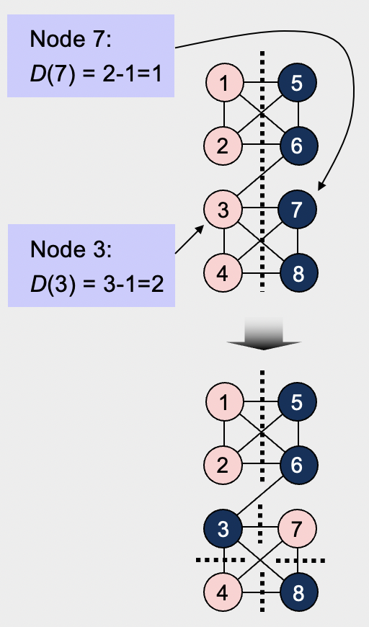
KL Algorithm (Terminology)
Gain of swapping a pair of nodes a und b
Δg = D(a) + D(b) - 2* c(a,b),
where
D(a), D(b) are the respective costs of nodes a, b
c(a,b) is the connection weight between a and b:
If an edge exists between a and b, then c(a,b) = edge weight (here 1),
otherwise, c(a,b) = 0.
Δg (3,7) = D(3) + D(7) - 2* c(a,b) = 2 + 1 – 2 = 1
=> Swapping nodes 3 and 7 would reduce the cut size by 1

Slide 17
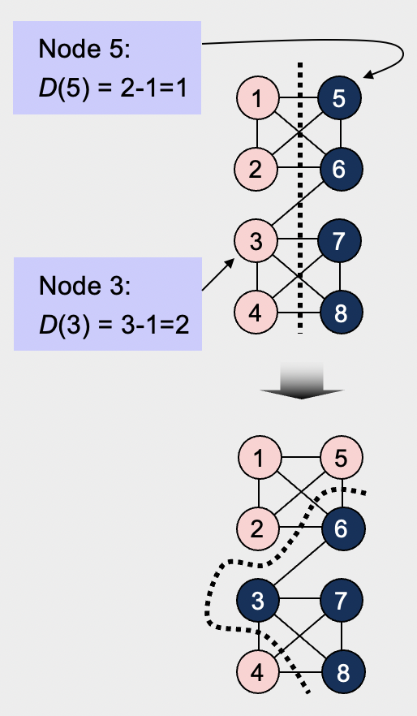
KL Algorithm (Terminology)
Gain of swapping a pair of nodes a und b
Δg = D(a) + D(b) - 2* c(a,b),
where
D(a), D(b) are the respective costs of nodes a, b
c(a,b) is the connection weight between a and b:
If an edge exists between a and b, then c(a,b) = edge weight (here 1),
otherwise, c(a,b) = 0.
Δg (3,5) = D(3) + D(5) - 2* c(a,b) = 2 + 1 – 0 = 3
=> Swapping nodes 3 and 5 would reduce the cut size by 3

Slide 18
KL Algorithm (Terminology)
Gain of swapping a pair of nodes a und b
The goal is to find a pair of nodes a and b to exchange such that Δg is maximized and swap them.
Maximum positive gain G_{m} of a pass
The maximum positive gain G_{m} corresponds to the best prefix of m swaps within the swap sequence of a given pass.
These m swaps lead to the partition with the minimum cut cost encountered during the pass.
G_{m} is computed as the sum of Δg values over the first m swaps of the pass, with m chosen such that G_{m} is maximized.

Slide 19
KL Algorithm (One-pass)

Slide 20
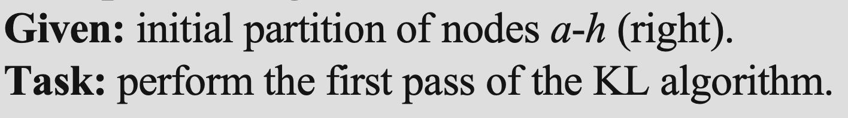
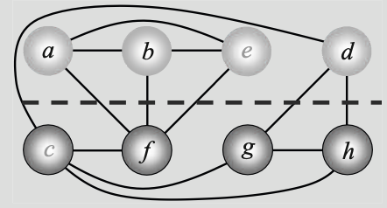
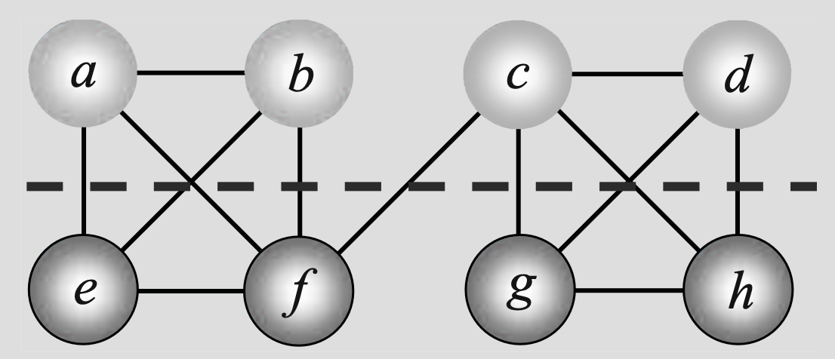
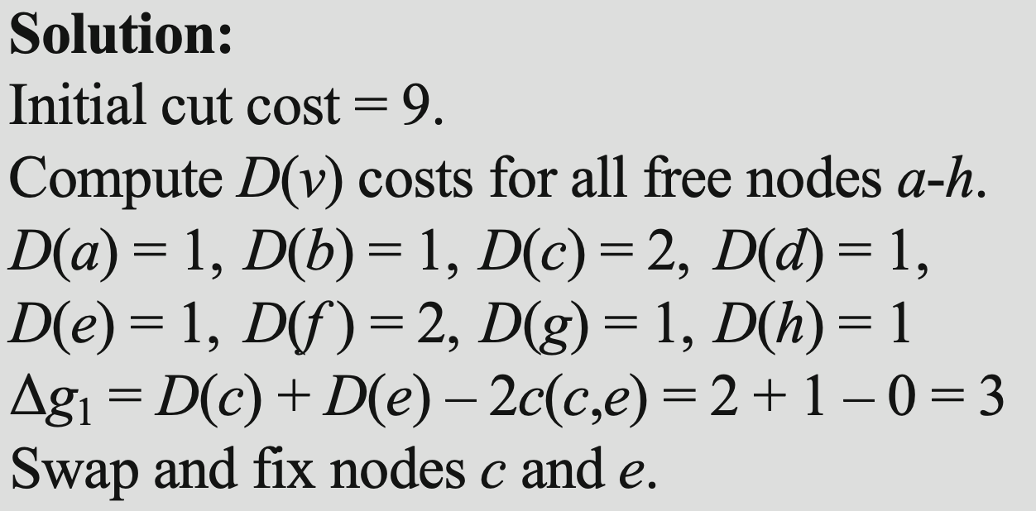
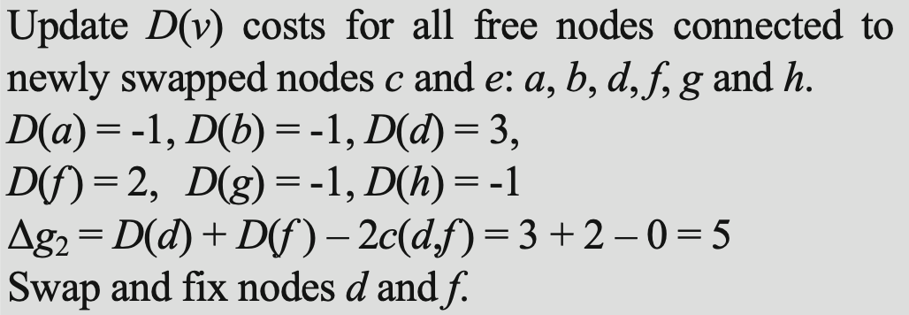
KL Algorithm (Example)

Slide 21
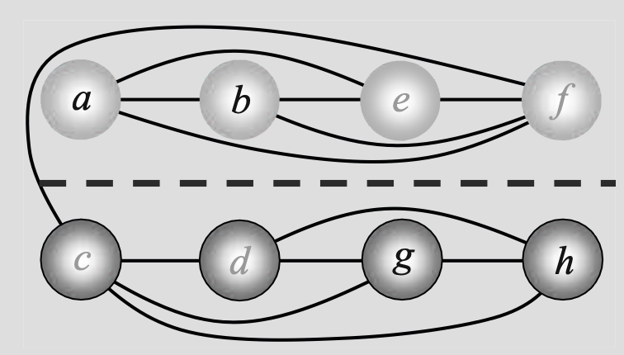
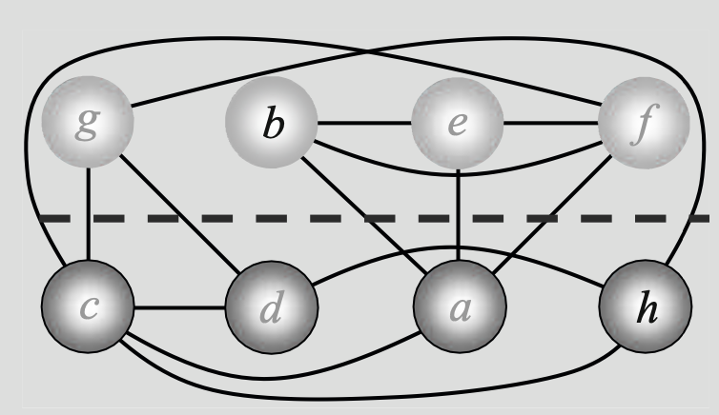
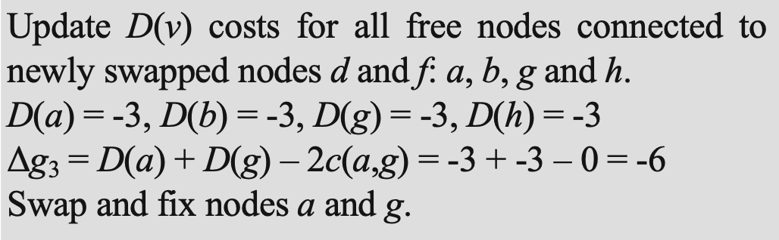
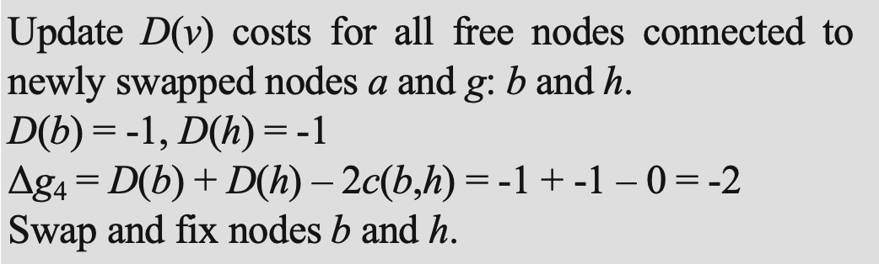
KL Algorithm (Example)

Slide 22
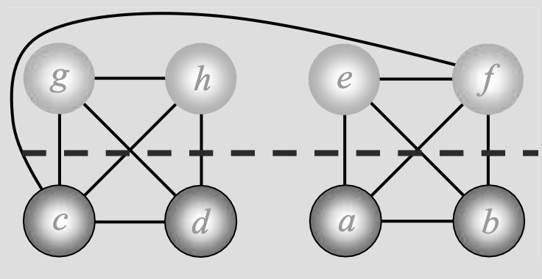
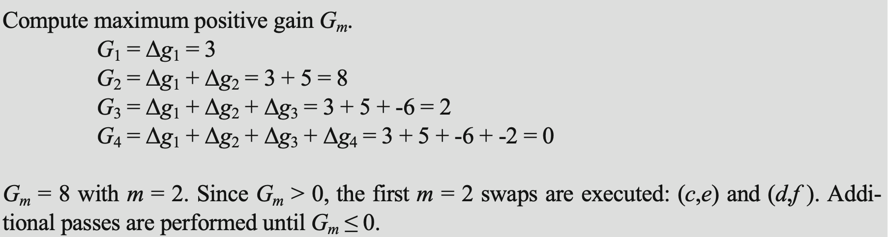
KL Algorithm (Example)

Slide 23
Thank you.

